Slide 2
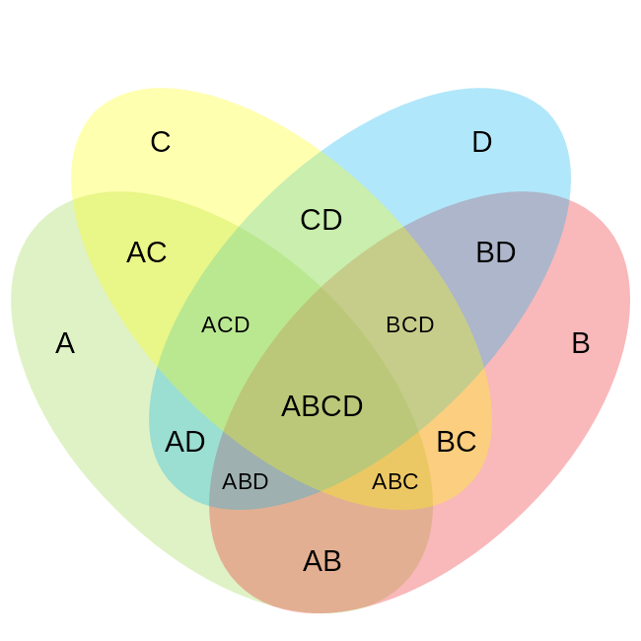
A = Meeting Attendees
B = EIP Authors
C = EIP Contributors
D = Client Contributors
N (Everyone Involved with Development) = 2,142
144
1,044
42
41
68
16
41
144
196
16
24
230
24
41
71

